Slide 1
Prompting and
reasoning models
How do I get reliable work out of an assistant?
Applied AI and Automation | Session 8 of 14
KLAi Professional Learning | Jotham Martin Wambi
Notes:
Welcome to Session 8. Last time we opened the model file and saw why size and licence decide rent, host or own. Whichever route you choose, you still have to talk to the model, so our question today is: how do I get reliable work out of an assistant?
A prompt can be weak or strong, like instructions to a new colleague, and that is an analogy. I will show recorded runs of both, a structured answer a program can check, and a calculation that one prompt got wrong and another got right.

Slide 2



Today in one view: what you will leave with
By the end of today you will have
Write a prompt with five parts, and test it on an evaluation set
Ask for a table or JSON so that the answer can be checked by a person or a program
Say what vendors advise for reasoning models, and check a calculation yourself
Notes:
That question gives you three things to be able to do. You can write a prompt with five parts and test it on an evaluation set. You can ask for a table or JSON so the answer can be checked. And you can say what the vendors advise for reasoning models, and check a calculation yourself.
The checking matters as much as the writing, because a confident answer can still be wrong.

Slide 3
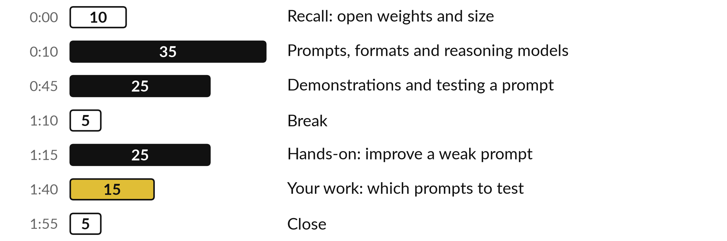
Your two hours: prompts, recorded
runs, then your own prompt
You rewrite a weak prompt on paper with the five-part checklist.
Notes:
To get you there, today has three big parts. First thirty-five minutes on the ideas: what a prompt is and its five parts, system and user prompts, few-shot prompting, delimiters, structured output, chain-of-thought, and what vendors say about reasoning models. Then twenty-five minutes of recorded runs, including one where a plain prompt got a payroll sum wrong, and how to test a prompt on an evaluation set.
After the break you rewrite a weak prompt on paper, using the five-part checklist, and decide which of your own prompts to test first.

Slide 4

Three questions from last time
1. What is the difference between open source and open weights?
2. How big is the weights file of a model with 7 billion parameters at FP16?
3. Is GGUF a file format or a level of precision?
Answer aloud first. Then we check together.
Notes:
Three quick questions from Session 7. Answer aloud first, and then we check together. It is a warm-up to bring last time back.
Question one. What is the difference between open source and open weights? Take a moment.
A good answer is this. Open weights means the trained parameters can be downloaded, under a licence that may still limit use. Open Source AI in the OSI sense also needs the training code, information about the training data and a licence without use limits.
Question two. How big is the weights file of a model with 7 billion parameters at FP16? Say it to yourself first.
A good answer is this. About 14 GB. Parameters times bytes per parameter, which is 2 bytes at FP16, with working memory needed on top.
Question three. Is GGUF a file format or a level of precision? Think about your own work as you answer.
A good answer is this. A file format. The number of bits per parameter is a separate choice called quantisation, and a GGUF file can hold FP16 or 4-bit parameters.
If an answer was missing, last session’s take-away sheet or workbook page has it. Now to today.

Slide 5
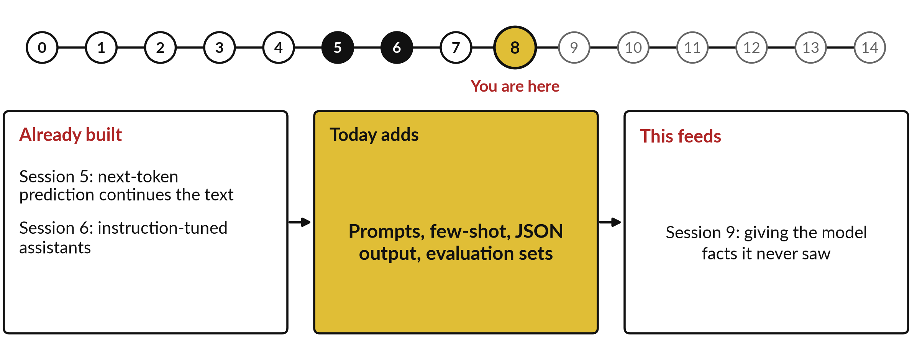
How today connects: what we
already have and what it feeds
Each session is built on the ones before it.
Notes:
So where does today sit in the story? The dots along the top are the fifteen sessions, from the map at Session 0 to your plan at Session 14, and the gold one is today.
We already hold next-token prediction continues the text from Session 5 and instruction-tuned assistants from Session 6. Nothing today starts from zero.
What today adds is this: prompts, few-shot, JSON output, evaluation sets.
And it feeds straight into what comes next. Session 9: giving the model facts it never saw. Keep that chain in mind, because each idea you learn today is a step on it.

Slide 6





Words we use today
Word | What it means
Prompt | The input text you give a model. A system prompt holds standing instructions. A user prompt is this request.
Zero-shot, few-shot | Zero-shot prompting gives only the instruction. Few-shot prompting adds a few worked examples (shots) first.
Chain-of-thought, reasoning model | Chain-of-thought asks the model to write its steps. A reasoning model works through the problem before it answers.
Structured output, delimiters | Structured output is an answer in a fixed shape such as JSON or a table. Delimiters are markers that separate data from instructions.
Temperature, evaluation set | Temperature is a setting for how the next token is picked. An evaluation set is test cases with known right answers.
Notes:
Five words for today. I give the plain meaning of each, and we use every one of them before the end of the session.
Prompt. The input text you give a model. A system prompt holds standing instructions. A user prompt is this request.
Zero-shot, few-shot. Zero-shot prompting gives only the instruction. Few-shot prompting adds a few worked examples (shots) first.
Chain-of-thought, reasoning model. Chain-of-thought asks the model to write its steps. A reasoning model works through the problem before it answers.
Structured output, delimiters. Structured output is an answer in a fixed shape such as JSON or a table. Delimiters are markers that separate data from instructions.
Temperature, evaluation set. Temperature is a setting for how the next token is picked. An evaluation set is test cases with known right answers.
Keep those words close. The first idea uses them straight away, so let us begin.

Slide 7
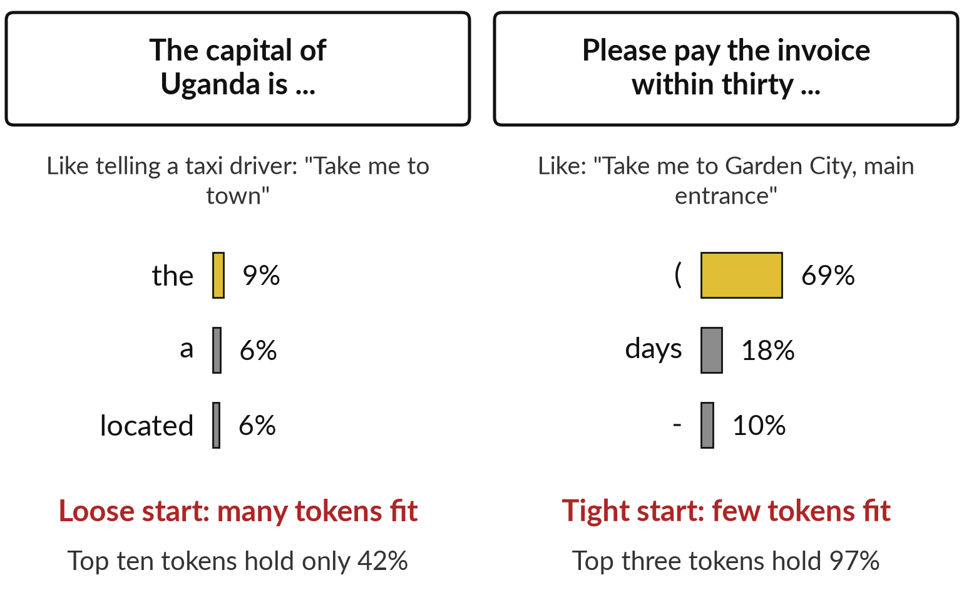
A prompt is the text the model continues,
so a tighter prompt gives a tighter answer
A prompt is the input text you give a model. As in Session 5, it predicts the next token, again and again.
Like a taxi driver: "town" leaves many places, a named entrance leaves one.
Temperature is a setting for how the next token is picked. Low favours the top token. High spreads the choice.
Notes:
Before we write any prompt, let me tie it to Session 5. A prompt is simply the text you give a model, and the model continues it by predicting the next token, then the next. Think of a taxi driver. Take me to town leaves hundreds of places.
Take me to Garden City, main entrance, leaves one. These two lists are real, from the small open model of Session 5. After the capital of Uganda is, the top ten tokens hold only forty-two percent between them. After please pay the invoice within thirty, three tokens hold ninety-seven percent.
Temperature changes how the next token is picked. Assistants are post-trained in Session 6 to follow instructions, but they still work this way.

Slide 8
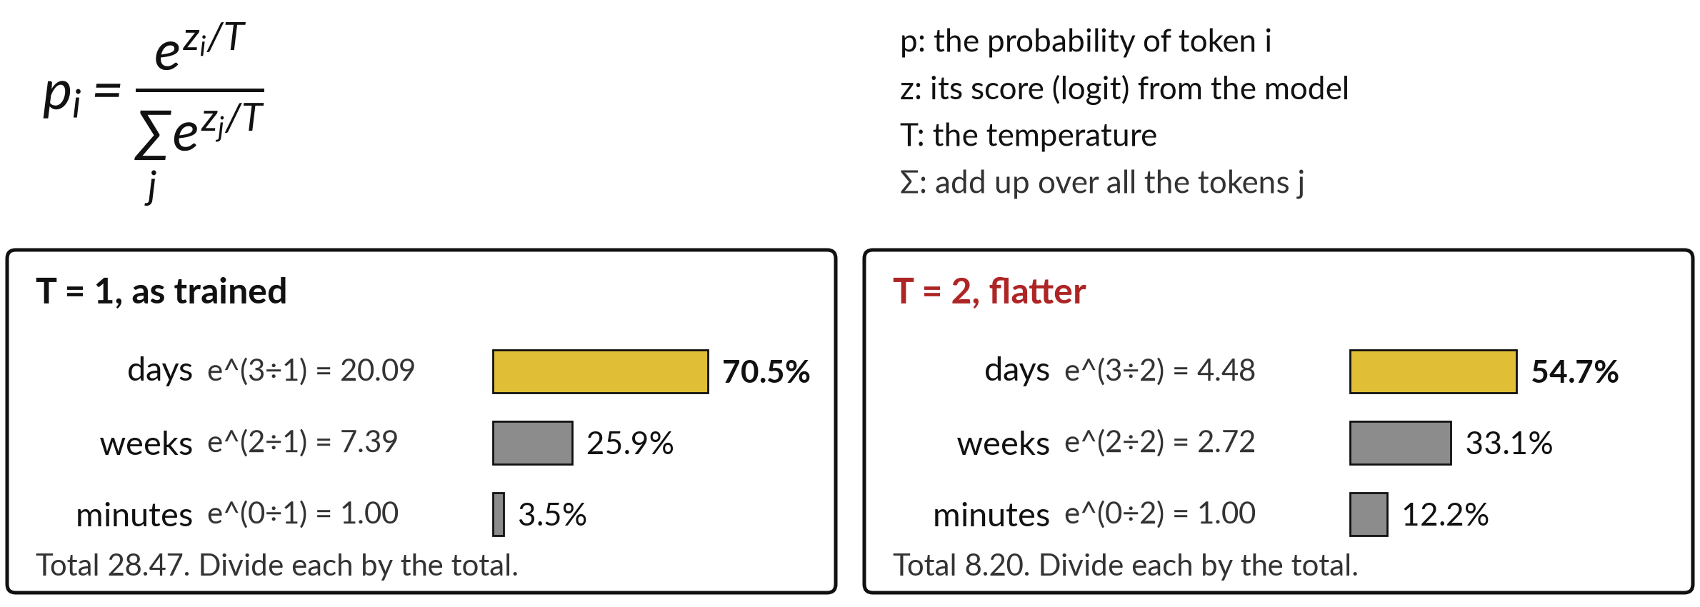
Temperature is the Session 5 formula:
divide each score by T before softmax
Logits 3, 2 and 0 from the Session 5 hands-on. Setting names and ranges differ by vendor.
Notes:
Before we go on, here is the formula behind the word temperature, recalled from Session 5. The model gives each possible next token a score, a logit, written z. Softmax turns the scores into probabilities: the probability of token i is e to the power z i over T, divided by the sum of the same quantity over all the tokens.
T is the temperature. Take the logits 3, 2 and 0 from your hands-on. At T equal to 1, you get 70.5, 25.9 and 3.5 percent. At T equal to 2 the scores are halved first, and you get 54.7, 33.1 and 12.2 percent, which is flatter. A low temperature favours the top token, and a high one spreads the choice. Chat apps often hide this setting.

Slide 9
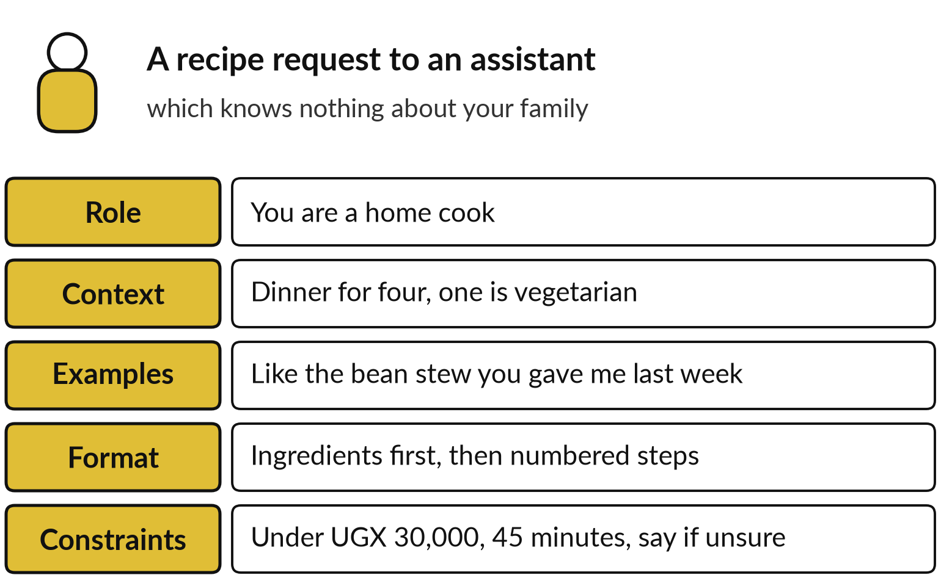
A prompt has five parts: role, context,
examples, format and constraints
Like instructions to a new colleague on day one. That is an analogy.
Role: who the assistant acts as. Context: what it needs to know.
Examples show the format. Constraints set limits and say what to do when unsure.
Notes:
A recipe request shows what a good prompt holds. Ask a stranger, make dinner, and you get a guess. Now say: you are a home cook, dinner for four, one is vegetarian, like the bean stew from last week, ingredients first then numbered steps, under thirty thousand shillings and ready in forty-five minutes, and tell me if you are unsure.
Those are the five parts: role, context, examples, format and constraints. As an analogy, it is the same as instructions to a new colleague, who knows nothing about your family or your company. The assistant knows nothing either. Let me show what that difference does to a real answer from our case company.

Slide 10
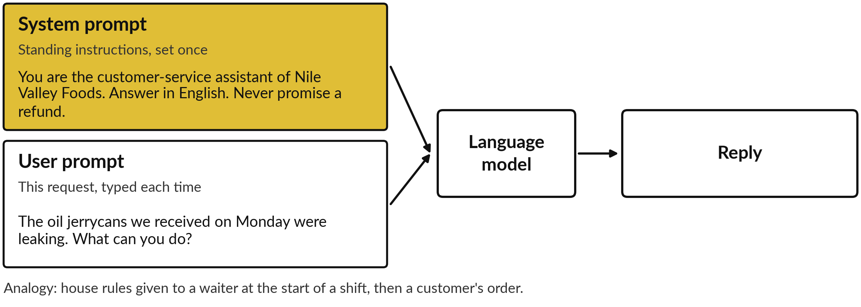
The system prompt sets standing rules;
the user prompt carries this request
The model reads both together. Chat apps usually show you only the user prompt.
Notes:
Most assistants take two kinds of prompt. The system prompt holds standing instructions that apply to every conversation: who the assistant is, the language, the limits. The user prompt is what a person types for this request. As an analogy, think of a restaurant: the house rules given to the waiter at the start of the shift, then each customer’s order.
At Nile Valley Foods, or NVF, which sells maize flour, sugar and cooking oil, the system prompt says you are the customer-service assistant, answer in English and never promise a refund. The user prompt is a customer message about leaking jerrycans. The model reads both together. In a chat app you usually write only the user prompt.

Slide 11
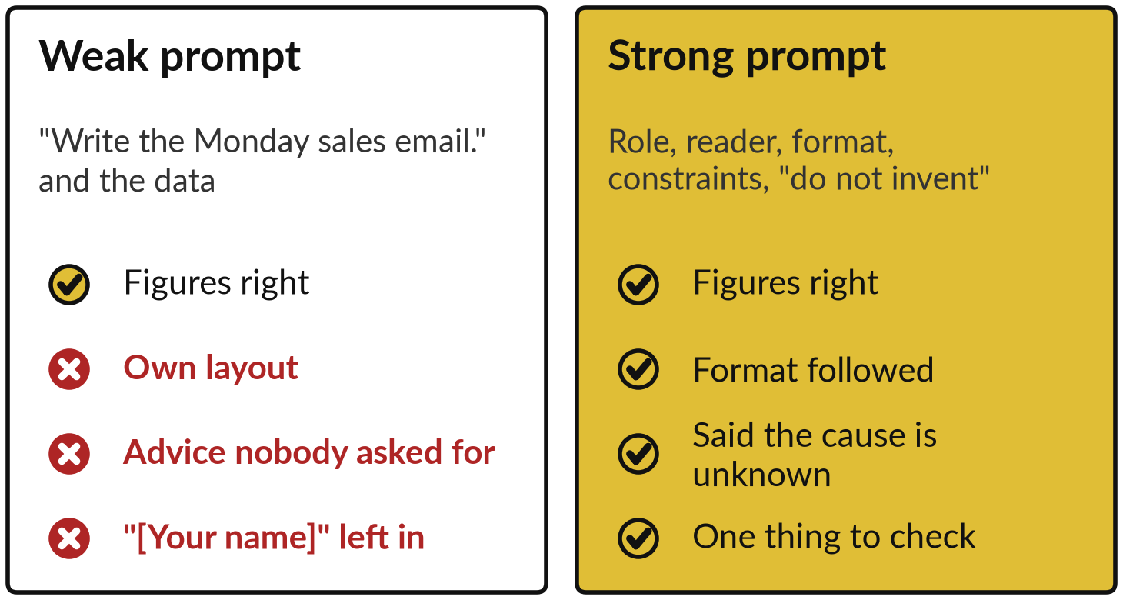
Demonstration 1: the same data
with a weak and a strong prompt
I will show
Watch for
Recorded runs, Claude fresh subagent sessions, 4 November 2026. Not ChatGPT or Gemini.
Both runs got the figures right.
Only the strong prompt followed a format, and it said what the data cannot explain.
Notes:
Here is the difference in practice. Each Monday, NVF sends its Sales Director a short email with last week’s sales. Both prompts gave the assistant the same sales data. The weak one said only, write the Monday sales email. The strong one named the role and the reader, set the format, said to use only these figures, and said to admit what the data cannot explain. These are recorded runs from 4 November, and I want you to watch for what each prompt changed.
In both, the figures came out right. The weak run chose its own layout, added advice to keep beans and sugar in stock, which nobody asked for, and left a placeholder for my name. The strong run followed the format and ended with one thing to check.

Slide 12
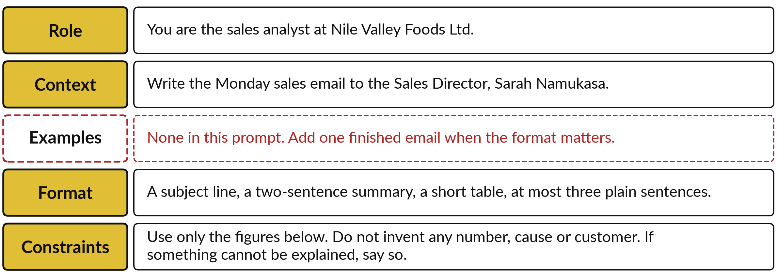
The strong prompt, taken apart: role,
context, examples, format and constraints
The strong prompt from the recorded run. It had no example. Add one when the format matters.
Notes:
So what made the strong one strong? Here it is taken apart. The role: you are the sales analyst. The context: who reads it. The examples are missing in this prompt. When the format really matters, paste one finished email and say, write the next one like this. The format: a subject line, a two-sentence summary, a table, at most three plain sentences. The constraints: use only these figures, do not invent a number, cause or customer, and say so if something cannot be explained.
On examples, Anthropic and Google list them among their advice. OpenAI says to try its reasoning models with none first. All three stress clear instructions and a stated format.

Slide 13
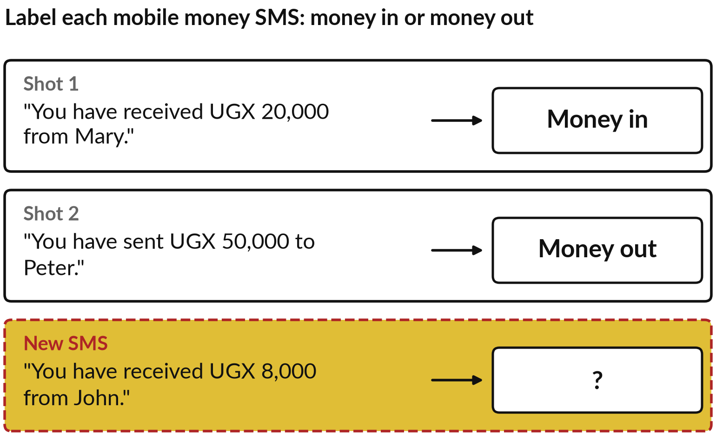
Few-shot prompting shows the format with
examples; zero-shot gives only the instruction
Each worked example is a shot. Show two, then give the new case.
Zero-shot: the instruction alone.
In symbols: P(output | instructions, examples, input), the answer given the text above.
Google: varied examples, same layout. Too many can overfit.
Notes:
That missing fifth part is our next idea, because an example can do what pages of description cannot. Take a mobile money SMS. Zero-shot prompting gives only the instruction: label each SMS as money in or money out. Few-shot prompting adds finished examples first, each one a shot.
Here two SMS carry their labels and the third is the new one. In symbols, the model gives the probability of the output given the instructions, the examples and the input. That is conditioning: your examples are part of the text it continues, so they fix the labels and the layout.
Google’s guide advises varied examples with identical formatting, and warns that too many can make the model overfit, as in Session 3. Test on cases that differ from your examples.

Slide 14
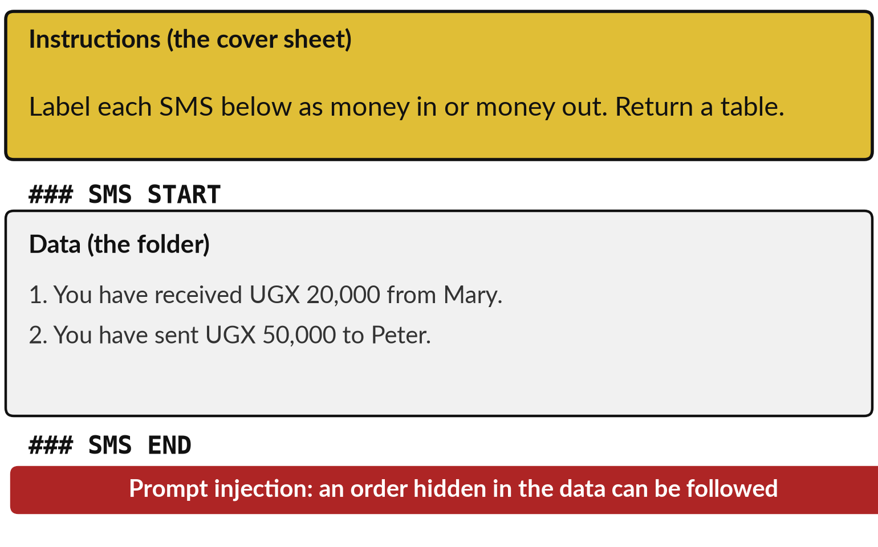
Delimiters mark the data off from the instructions
A delimiter is a marker such as ### that shows where data starts and ends.
Like a cover sheet and a folder: instructions, then papers.
OpenAI suggests markdown or XML tags as delimiters.
A delimiter does not make text safe.
Notes:
Once examples and data are both pasted into a prompt, the assistant has to tell which is which. In an office, a cover sheet says what to do and a folder holds the papers. In a prompt you build the same structure with delimiters, which are markers that show where one part ends and another begins. The instructions come first. Then a line such as three hash signs, SMS start, then the data, then SMS end.
OpenAI’s guide for its reasoning models suggests delimiters like markdown or XML tags. The markers help the model see where the data is. They do not make the data safe. An SMS can contain an order, and the assistant may follow it. That is called prompt injection, and we return to it in Sessions 10 and 11.

Slide 15
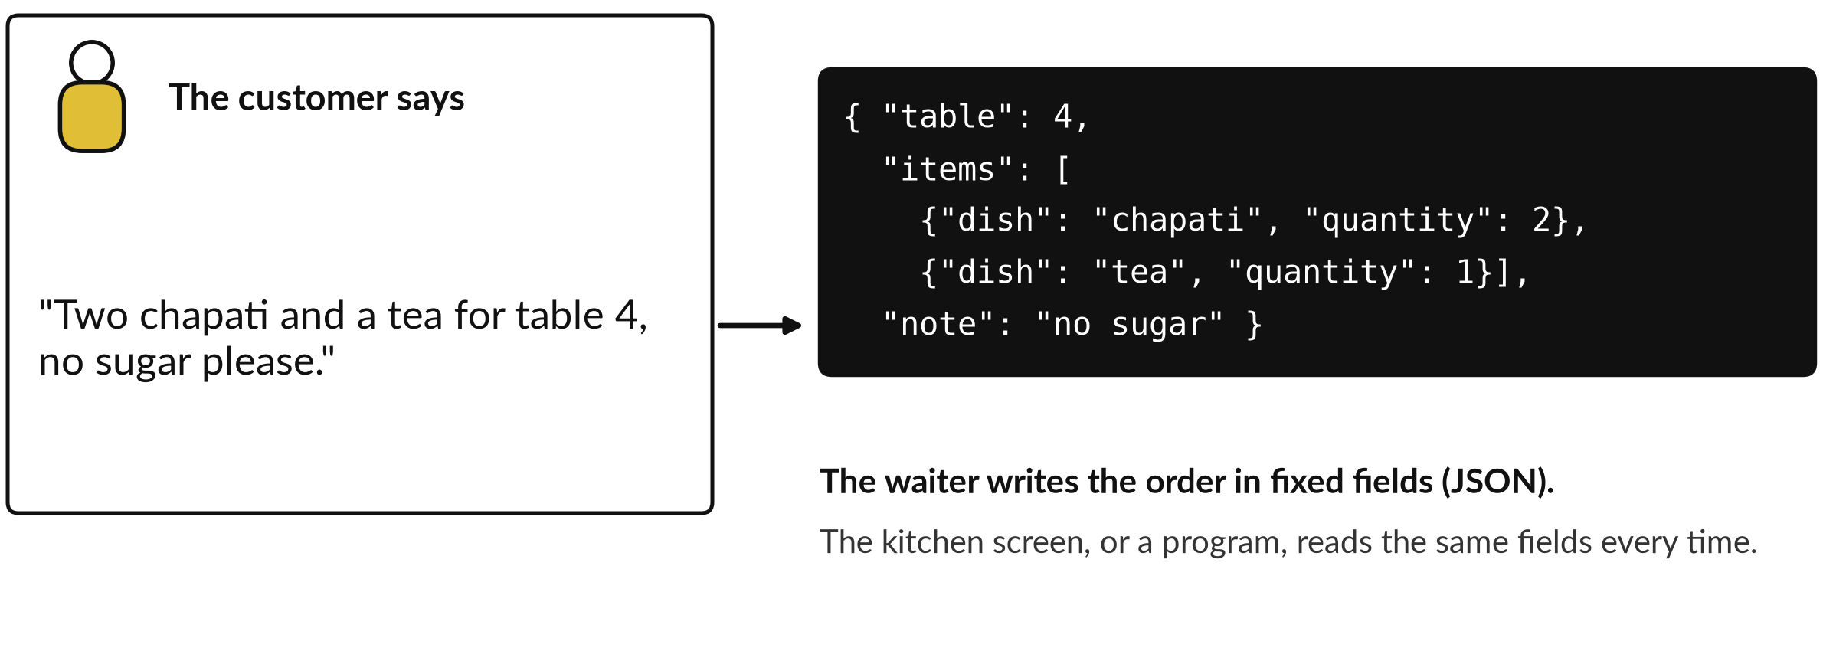
Structured output: the answer in
fixed fields, like a restaurant order slip
JSON (JavaScript Object Notation) is a plain-text format of named fields that any program can read.
Notes:
Before the next demonstration, an everyday case. A customer says, two chapati and a tea for table four, no sugar please. A good waiter writes it in fixed fields: the table, the dishes with quantities, a note. The kitchen reads the same fields every time. That is structured output: asking the model for an answer in a fixed shape, often JSON, a plain-text format of named fields that any program can read.
Without a fixed shape, each reply is written differently and a program cannot rely on it. A table does the same for a person reading. Let me show it on four customer messages from NVF.

Slide 16
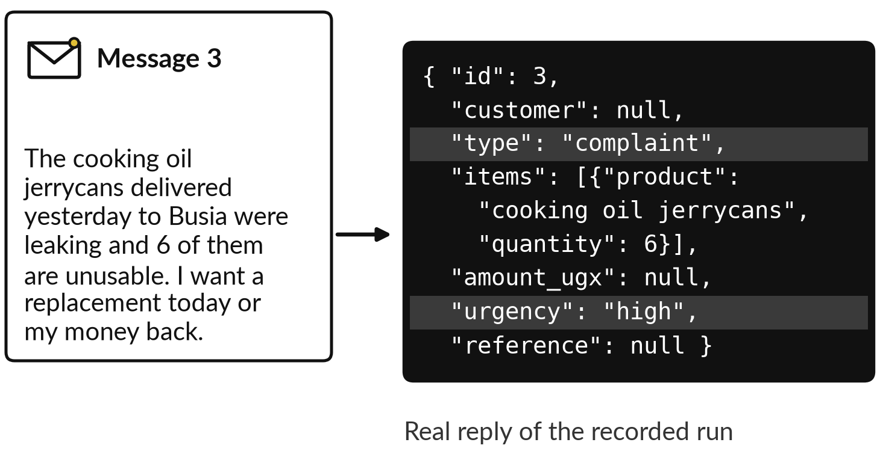
Demonstration 2: ask for JSON,
and a program can check the reply
I will show
Watch for
Recorded run, Claude fresh subagent, 6 November 2026. One run.
Four messages came back as four records with fixed fields.
The highlighted fields are the type and the urgency.
Notes:
Those prompts produced writing for a person to read. Sometimes a program has to read the answer, and that is structured output. This is a recorded run, and I want you to look at the type and the urgency in the highlighted fields. I gave the assistant four invented customer messages from Nile Valley Foods and a list of exact fields: customer, type, items, amount, urgency, reference.
The prompt said, use only what the message says and use null if a field is missing. This is message three, the leaking jerrycans. The record names the type as complaint, the six unusable jerrycans, and the urgency as high. The point is that a fixed format can be checked.

Slide 17
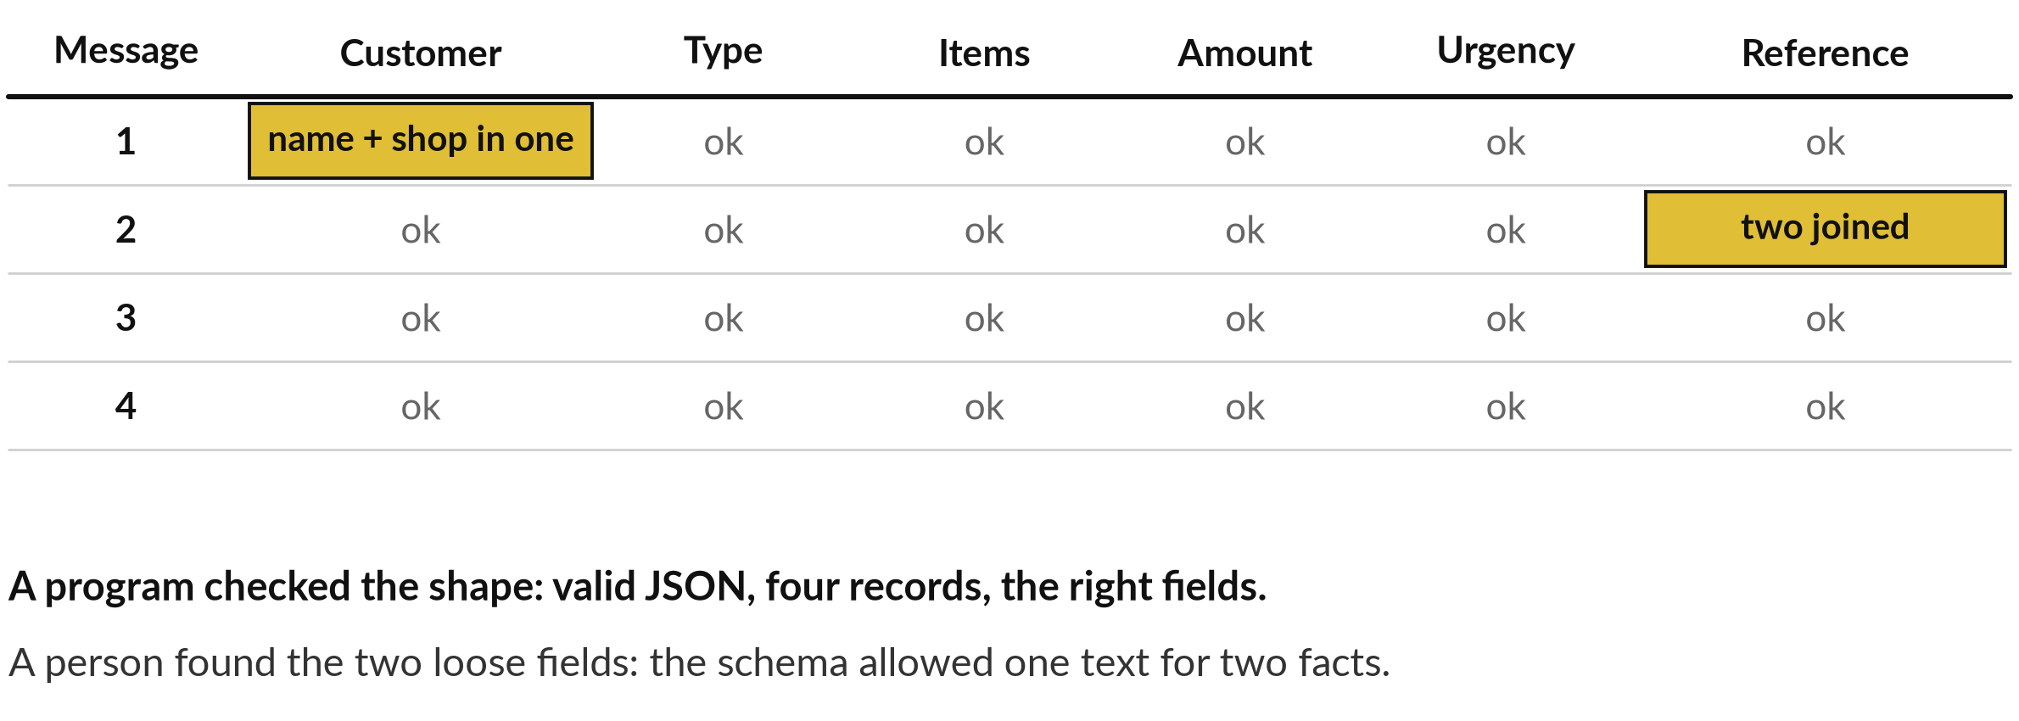
A fixed format let a program check the
shape and a person find two loose fields
Fix to try: split the reference into invoice number and payment reference, then run again.
Notes:
So did that reply earn our trust? I checked it in two ways. A short program confirmed that it was valid JSON, with four records and exactly the fields I asked for. Then I read each field against the message. Everything matched except two. For message one, the customer came back as Mary and the shop name in one field.
For message two, the invoice number and the mobile money reference came back joined in one field, because my prompt allowed only one reference. The fault lies in my prompt, and the answer was fine. The cure is to split the field and run it again. Format checks catch the shape. A person still checks the meaning.

Slide 18
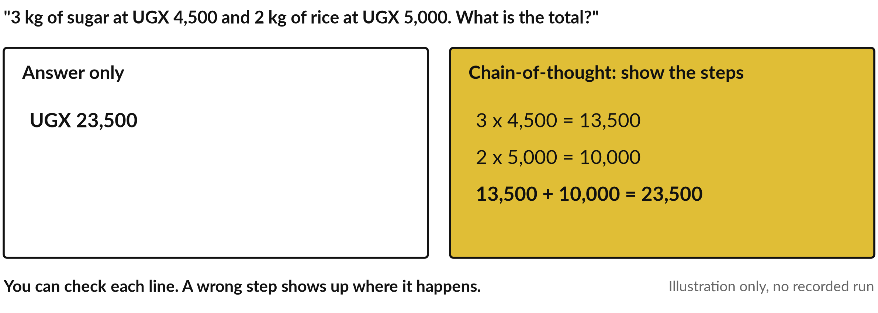
Chain-of-thought prompting asks the model
to write its steps, so you can check them
A shop bill as an illustration only, with no recorded run. Reasoning models do this on their own.
Notes:
Another technique is chain-of-thought prompting: you ask the model to write out its reasoning steps before the final answer. Take a shop bill: three kilograms of sugar at four thousand five hundred shillings and two kilograms of rice at five thousand. An answer-only reply gives one number that you must trust.
With chain-of-thought each line is written, so you can check each multiplication and the addition. Published work has found it often helps on multi-step problems, but it does not guarantee a right answer. This picture is only an illustration, and no run was recorded for it. Reasoning models do this thinking on their own, and that comes next.

Slide 19
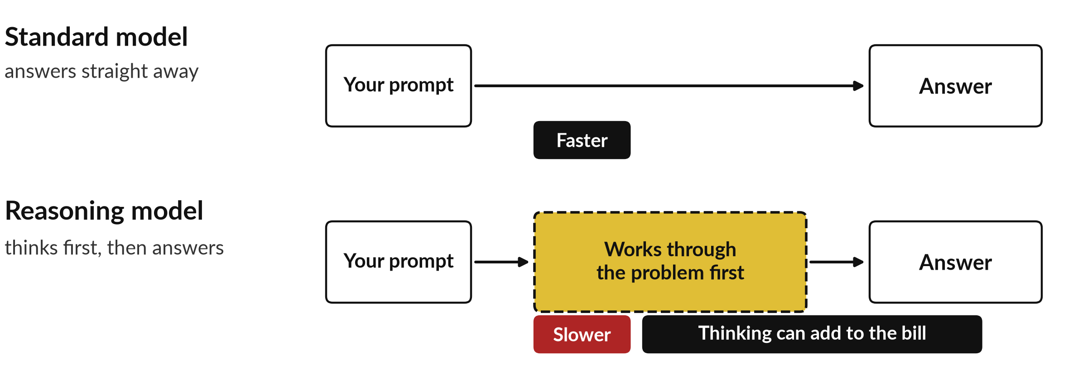
A reasoning model works through
the problem before it answers
Vendors describe this differently. Their own words are on the slide after this.
Notes:
In Session 6 you met reasoning models. Here is the practical picture. A standard model answers straight away. A reasoning model, or a standard assistant with its thinking switched on, spends extra time working through the problem before it replies. That can help with multi-step problems like the payroll sum.
It also takes longer, because the thinking is extra text made of tokens, and that can add to the bill, so it is not the right choice for every task. I did not record a reasoning model against a standard one today. A fresh session has no thinking switch, so I will show that live on the assistant you use. First, what do the vendors themselves advise?

Slide 20
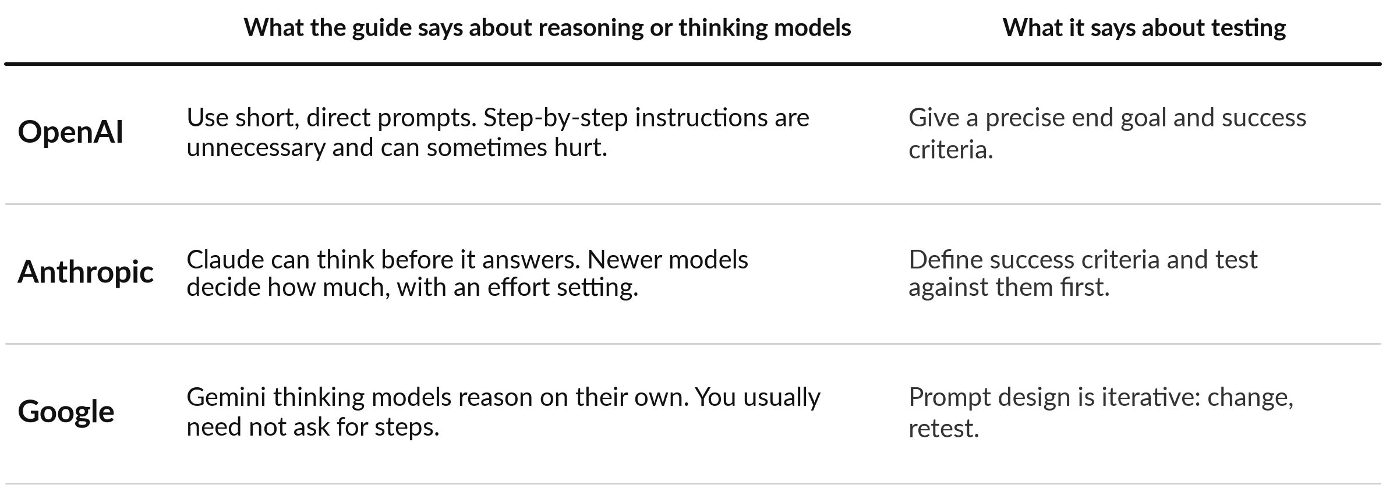
The vendor guides agree: state
the goal and the limits, then test
Guides read on 6 November 2026. Product names and settings change often.
Notes:
Here is what each vendor says about prompting these models, in its own terms, and I add nothing. OpenAI’s guide for its reasoning models says to use short, direct prompts, and that asking for step-by-step reasoning, chain-of-thought, is unnecessary and can sometimes hurt. Anthropic says its models can think before answering, and that newer models decide how much, with an effort setting.
Google says its Gemini thinking models reason on their own, so you usually need not ask for steps. On testing they agree in spirit: a precise end goal, success criteria, and iterate. So for a reasoning model, state the problem, the rules and the output, and leave the working to it. I call that a framed prompt, and the next test uses one.

Slide 21
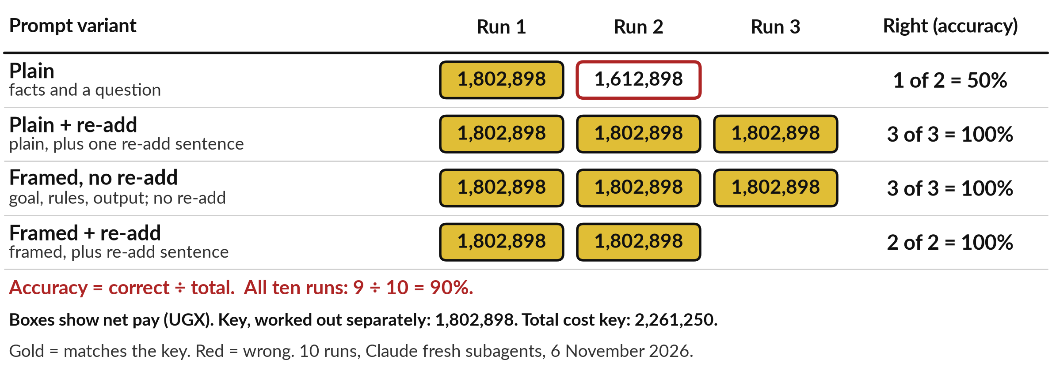
Demonstration 3: one calculation, four
prompts, changing one thing at a time
Accuracy = correct ÷ total. Ten recorded runs, 9 right, so 9 ÷ 10 = 90%.
Notes:
Here is that testing in action, on a calculation. Payroll means pay for the month: salary, plus overtime, minus an unpaid leave day, minus pension and an advance. The key was worked out separately and checked twice. A framed prompt states the goal, the rules and the output format first.
My first comparison was unfair: the framed prompt differed from the plain one in two ways, the framing and a closing sentence to re-add the lines. So I made two controlled variants, each changing one thing. Accuracy is correct divided by total. Plain: 1 of 2, which is 50 percent.
Plain plus the re-add sentence: 3 of 3. Framed without it: 3 of 3. Framed with it: 2 of 2. Overall 9 of 10, 90 percent. Ten runs cannot say which change helped.

Slide 22
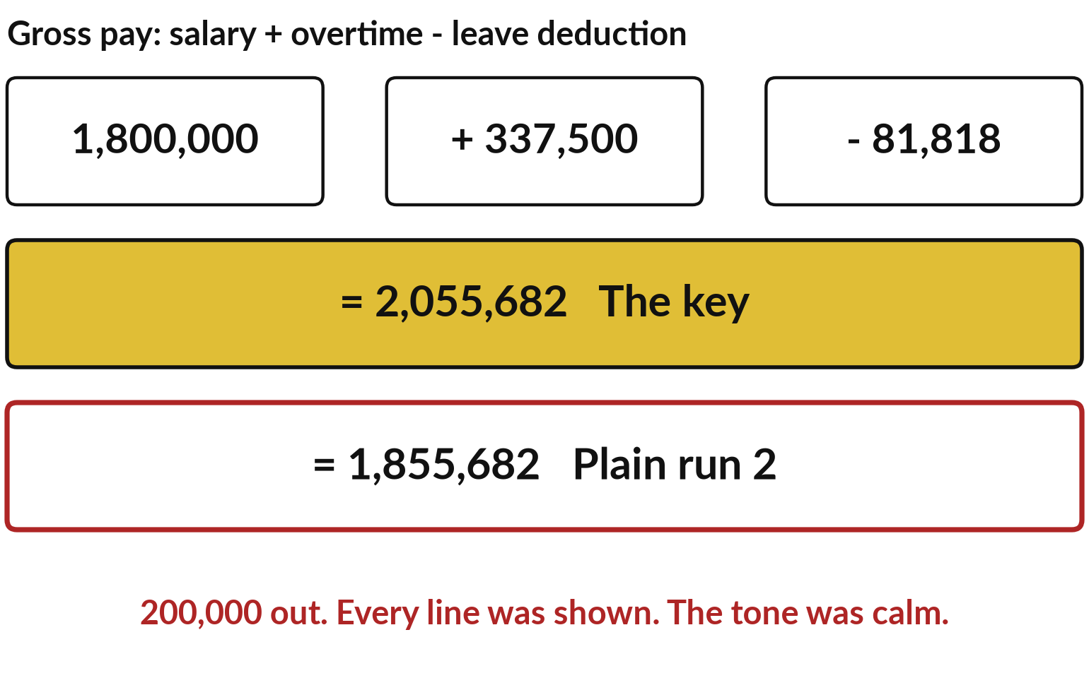
The wrong plain run was 200,000 out,
showed every line and sounded sure
Re-add it yourself: 1,800,000 plus 337,500 minus 81,818.
The key gives 2,055,682.
Plain run 2 wrote 1,855,682.
Re-add the lines that matter.
Notes:
Only one run in ten was wrong, and it is worth a close look. This is the wrong run, line by line. Every step was shown and the tone was calm. But the gross pay, the pay before deductions, added up to 1,855,682, and the key says 2,055,682. A slip of 200,000 shillings, and every figure after it was wrong, the net pay and the total cost.
You can catch this in a minute with a calculator: salary, plus overtime, minus the leave deduction. That is the habit. Ask for the working so that you can check it, and recompute the figure that everything else depends on. Neither a calm tone nor the shown working proves a sum is right. Results also vary from run to run, because the next token is sampled.

Slide 23
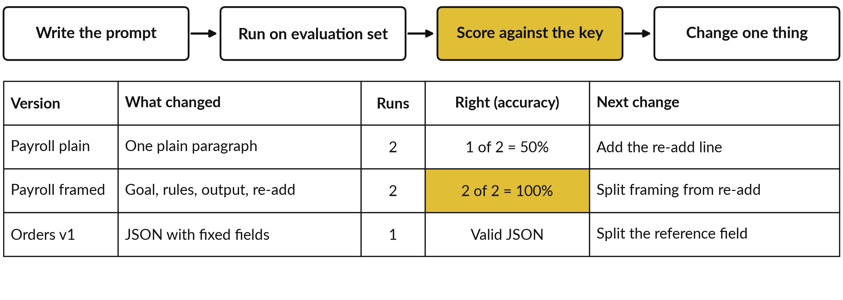
A prompt is tested on an
evaluation set, like anything else
Accuracy = correct ÷ total. Small sets show a pattern and prove nothing.
Notes:
That is the habit for one reply. Checking a prompt across many replies is better, and that is how you improve it. An evaluation set is a collection of test cases where you know the right answer. Write the prompt, run it on the set, score the answers, change one thing, and run again, as you would test a new supplier. Anthropic’s guide says to define success criteria and a way to test them before refining.
Keep a log. Mine shows the payroll prompt you just saw, plain and framed, with two runs each, and the orders prompt with one run. Look at the Right column: accuracy, which is correct divided by total. Two runs is a small set, and a real evaluation set has ten or more cases. Which task of yours has cases with known answers?

Slide 24
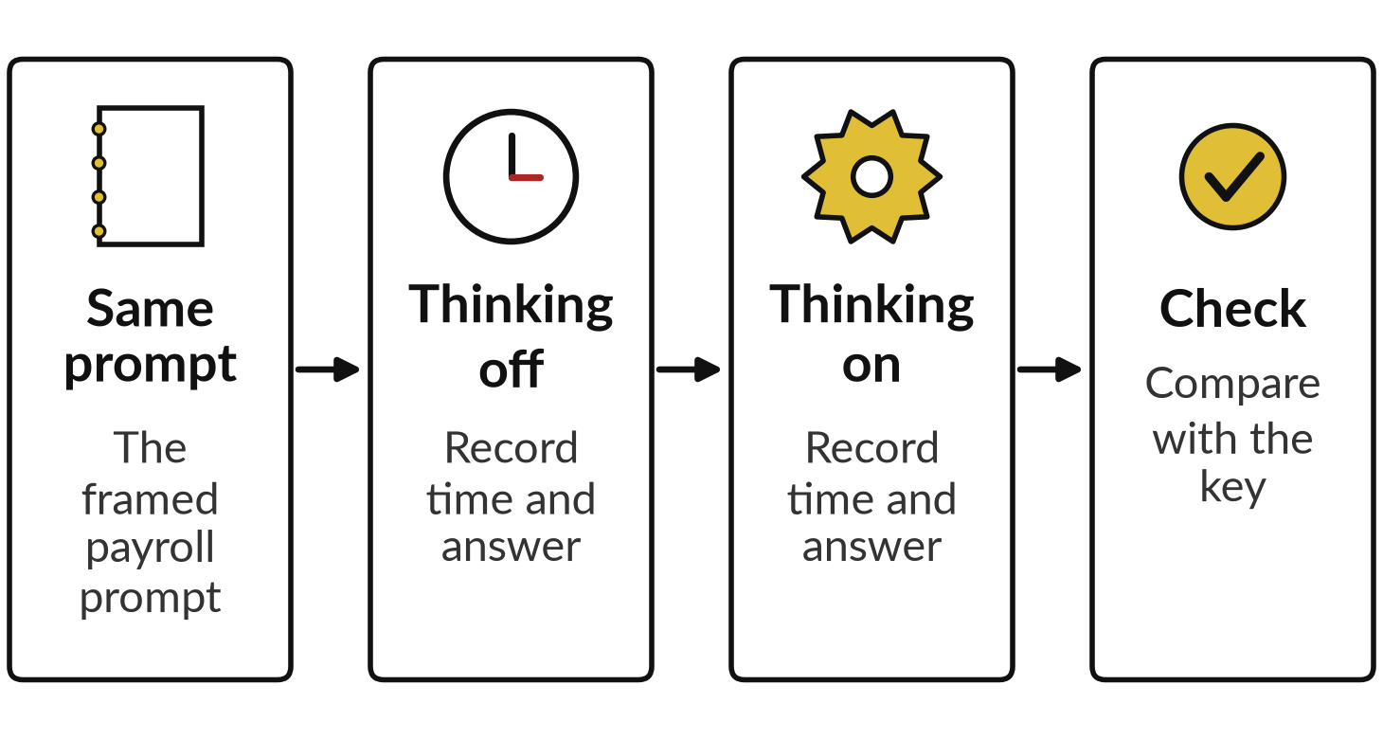
Demonstration 4, live: the same
prompt with thinking off, then on
I will show
Watch for
Live, on your assistant. Results vary from run to run.
Time taken and the length of the answer.
Whether the net pay matches the key.
Notes:
Time to try it, live, on the assistant you use, and nothing here is recorded. Many assistants have a switch that lets the model think longer. I paste the same framed payroll prompt twice, once with thinking off and once with it on. Watch the time each takes and the length of the answer, and then I compare the net pay with the key, 1,802,898.
Results vary from run to run, so one try proves nothing. If your assistant has no such switch, we use the recorded runs instead. Whatever the result, the final step is the same: you check the figure that matters.

Slide 25



Which kind of model to start
with depends on the task
Task | Start with | Why
Sort messages, rewrite, short summary | A standard model | Well defined and quick; OpenAI says fast, defined tasks suit standard models
Multi-step sums, plans, tangled rules | Thinking on | Extra working time can help; you still re-add the lines
Anything with money, law or people | Either, then check by hand | Our plain run was wrong with every line shown
A starting view. Test it on your own cases, and ask your IT lead what the thinking costs.
Notes:
What did you see with thinking on and off? Whatever it was, it leads to the question of which model to start with, and this is a starting view that you test. For well-defined jobs such as sorting messages, rewriting or a short summary, start with a standard model. OpenAI’s guide says fast, well-defined work suits its standard models, and that planning and ambiguous complex problems suit its reasoning models.
For multi-step sums, plans or tangled rules, turn thinking on, and still re-add the lines. And for anything involving money, law or people, either kind, followed by a check by hand. Our own plain run was wrong with every line shown. Ask your IT lead what thinking costs on the plan you use.

Slide 26
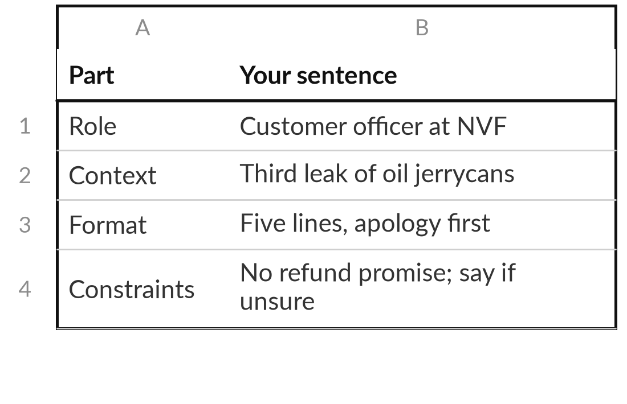
Improve a weak prompt
with the five-part checklist
25 minutes
Hands-on, no computer
Rewrite the weak prompt: "Reply to this customer complaint."
Name the role and the reader.
Add the context: what happened, which customer.
Add one example, or write "none yet".
State the format and length.
Add the constraints, and what to say when unsure.
You keep: A rewritten prompt, checked against all five parts, ready for your log.
Notes:
Time for you to use the checklist. This part is on paper, with no computer, and you have twenty-five minutes. Take the weak prompt on the slide, reply to this customer complaint, and rewrite it using the five parts, just as we did for the recipe. Name the role and the reader. Add the context: what happened and which customer. Add one example, or write none yet.
State the format and the length. Add the constraints and what to say if the assistant is unsure. Then read your prompt aloud as if you were the new colleague. What would you still have to guess?
If your own work is better, use that. I will come round and read your drafts.

Slide 27




Which of your prompts will
you test first, and how?
Which prompt do you use often enough to test properly?
Save it
Test it
Structure it
Keep a person
Write it in the prompt template.
Run it on an evaluation set of ten cases.
Ask for a table or JSON so it can be checked.
Name who checks the figures before use.
Write the prompt, the first test and who checks it.
Notes:
You have rewritten one prompt, so now think about the prompts you really use. This is your decision. Think of the prompt you use most often. Will you save it in the template? Will you test it on an evaluation set of ten cases where you know the right answer?
Will you ask for a table or JSON so that the answer can be checked? Or will you name the person who checks the figures before anything is used? Most prompts need two or three of these. Write down the prompt, the first test you will run, and who does the check. Which prompt did you choose, and what could it get wrong?

Slide 28
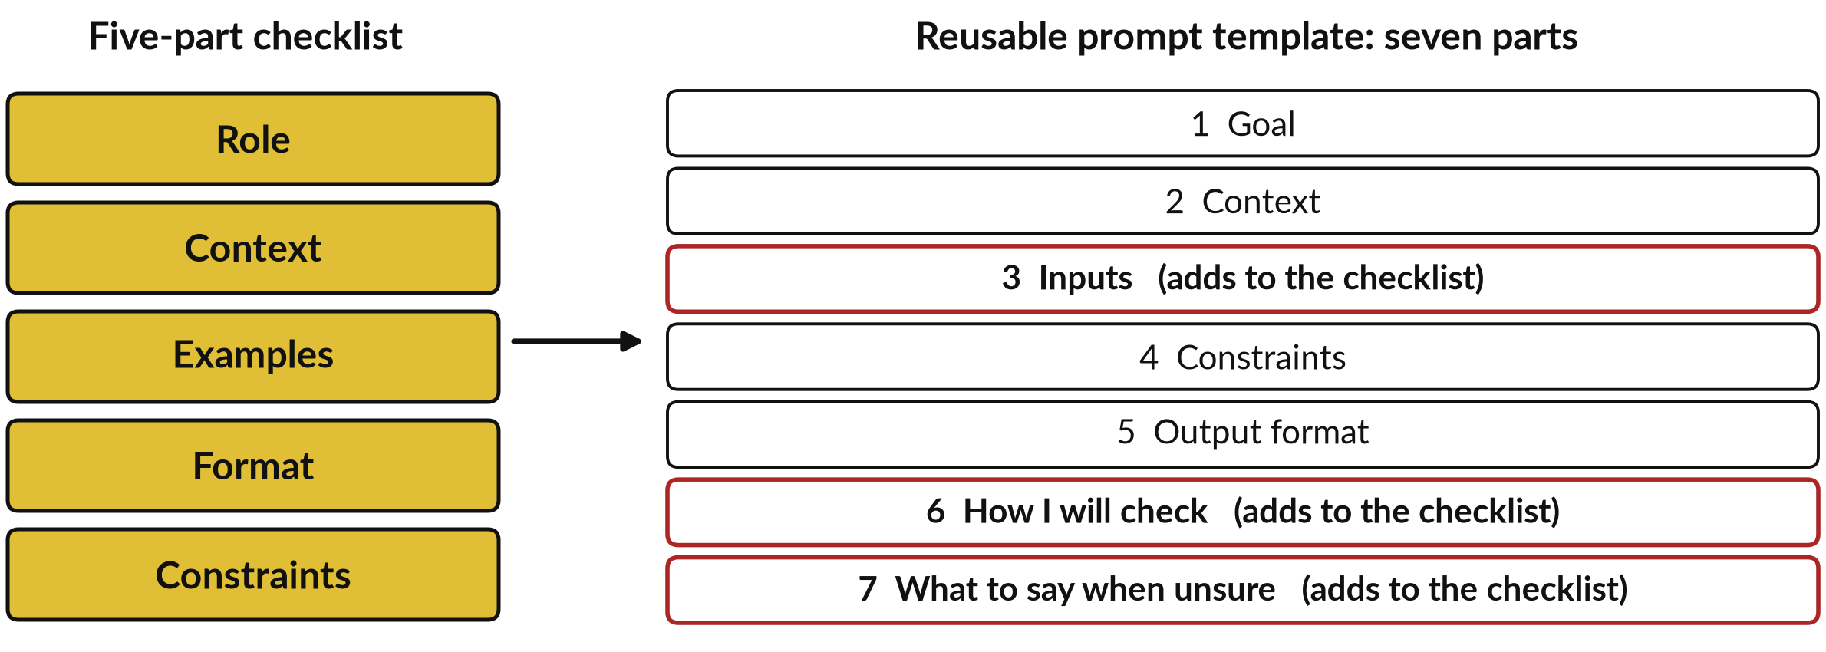
Your five-part checklist grows into the
seven-part prompt template you keep
Templates/Reusable Brief Template.docx (the file keeps its old name). Examples go with the inputs.
Notes:
Whichever you chose, all of it needs one place to live, and you already have it. The reusable prompt template has seven parts. The five-part checklist from today fits inside it. The goal and context cover the role and the context. Output format is the format, and constraints are the constraints. It adds three things, shown in red.
Inputs say exactly what you give the assistant, and that is also where an example goes. How I will check says how you will test the answer on your evaluation set. And what to say when unsure is the cheapest guard against an invented answer. Use the template, and record each version in your prompt log. Those two are what you keep today.

Slide 29
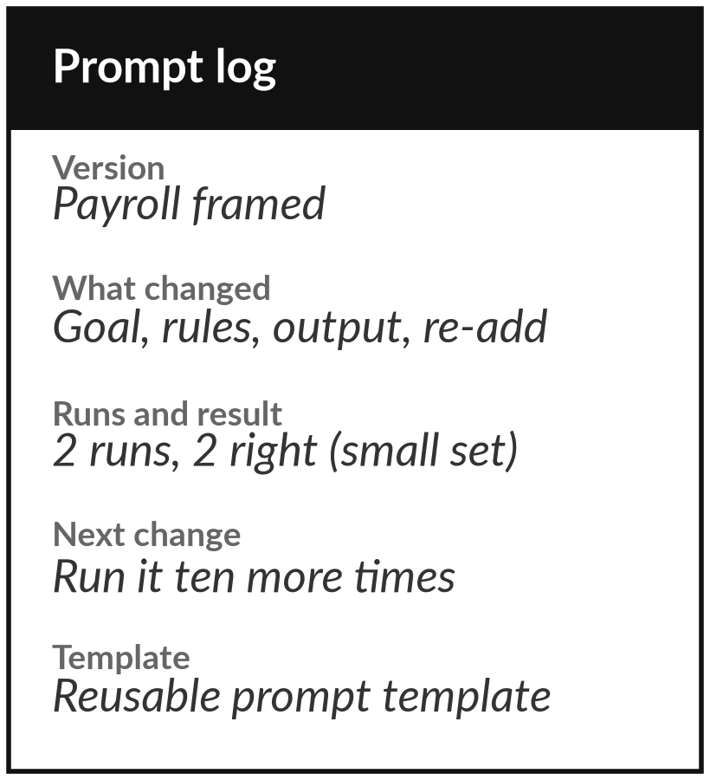
Keep the template and the log,
and test every prompt you reuse
What you keep from today
A reusable prompt template and a prompt log, so that every prompt you keep has been tested on an evaluation set.
Our question today
How do I get reliable work out of an assistant?
Next session
Session 9: Giving a model your knowledge: retrieval-augmented generation and fine-tuning. Bring one question that needs your documents.
Notes:
Take the template and the prompt log. The template is the reusable prompt template you already have, and the log records each version, what changed and how many runs were right. Reliable work comes from a clear prompt, an evaluation set and a person who checks the figure that matters.
Test every prompt before you reuse it. Next session is about giving a model your own knowledge: retrieval-augmented generation, long context and fine-tuning. Bring one question that needs your own documents.
We began with this question: How do I get reliable work out of an assistant? Before you go, say in one sentence what you can now say about it.

